Slide 1
Agent Network MVP
Managing agent network on system

Slide 2

Challenge
Need to move the management of KOKO’s agent network ‘on system’ and away from spreadsheets. However this effort involves 7 teams operating >35 processes.
Some processes are well defined while others need redesigning.
Not all the processes need to be done on system but enough data needs to be there to stop people reverting to spreadsheets.
Some processes are already on system but they are not integrated with wider processes run by other teams.
The challenge is drawing a ‘line’ to ensure enough of the process is online to ensure data is maintained on system, but without replicating processes on system which would yield little value or need rework in the near future.

Slide 3
MVP for managing Agent Network on system
The MVP (minimum viable product) for managing the agent network on system is constantly changing as we learn more about running the business.
Replicating existing fields in spreadsheet covers the goal of replacing spreadsheets but will quickly be out of sync if another process not on system changes that status.
Replicating all processes on system will take time and mean value of the UVA workstream won’t be achieved until late 2021.
The MVP is somewhere in the middle taking into account how agents, shops and KPs move through the lifecycle.
It’s important to note the MVP is not the end of development on the agent network platform ….
Time
Agent Network Processes
All agent related processes on system.
MVP
Replicating fields in spreadsheet

Slide 4
Agents, shops and KPs
An agent is the individual with who KOKO enters an agreement to provide KOKOpoints.
The shop is the location the agent provides for KOKOpoints. An agent can own many shops.
Customers visit shops to buy fuel from KOKOpoints. We are trialling multiple KPs in shops.
Each of these entities have their own lifecycle which is often dependent on an event / process of another entity. For example a shop is only active once a KP has been deployed and commissioned.
Agent
0..1
owns
1..n
Shop
1..n
houses
Entity | Lifecycle Phases
Agent | Prospect | Active | Inactive
Shop | Enrolled | Operational | Terminated
KOKO Point | Warehouse | Deployed | Scrapped
..n
KOKOpoints

Slide 5
Agent Process Outline
Agent | Prospect Agent Recruitment (AN) Agent KYC (Legal) | Active Payments (Finance) Termination (Agent Network) | Inactive
Shop | Prospect Shop Selection (AN) Shop KYC (Legal) Contracting (Legal) Payments (Finance) Inspection (Deployment) Civil Works (Deployment) Branding (Marketing) Shop readiness (Deployment) | Active Commissions (Finance) Agent Sales (AN) Termination (AN) Relocation (AN) Suspension (AN) Deliver Inventory (Cookers) | Archive Final dues (Finance) Retrieve Inventory (Deployment) Retrieve Branding (Deployment)
KOKO Point | Warehouse QC (Deployment) Repairs (Deployment) Deliver (Deployment) KP readiness (Deployment) Install (Deployment) Fuelling (Fuels) Calibration (Deployment) | Deployed Commission (NOC) Fuelling (Fuels) Maintenance (NOC) Calibration 2.0 (Deployment) Relocation (Deployment) Decommission (Deployment) | Scrapped Repair (Deployment) Break down (Deployment)
We brainstormed all the current processes that take place and mapped them to the relevant entity and lifecycle phase.
Individual processes have different owners and actors (see brackets) even though the overarching network is managed by the Agent Network Team.

Slide 6
Agent Process MVP
Agent | Prospect Agent Recruitment (AN) Agent KYC (Legal) | Active Payments (Finance) Termination (AN) | Inactive
Shop | Prospect Shop Selection (AN) Shop KYC (Legal) Contracting (Legal) Deposits (Finance) Inspection (Deployment) Civil Works (Deployment) Branding (Marketing) Shop readiness (Deployment) | Active Commissions (Finance) Agent Sales (AN) Termination (AN) Relocation (AN) Suspension (AN) Deliver Inventory (Cookers) | Archive Final dues (Finance) Retrieve Inventory (Deployment) Retrieve Branding (Deployment)
KOKO Point | Warehouse QC (Deployment) Repairs (Deployment) Deliver (Deployment) KP readiness (Deployment) Install (Deployment) Fuelling (Fuels) Calibration (Deployment) | Deployed Commission (NOC) Fuelling (Fuels) Maintenance (NOC) Calibration 2.0 (Deployment) Relocation (Deployment) Decommission (Deployment) | Scrapped Repair (Deployment) Break down (Deployment)
Then we outlined which processes must be online and should be online in order to stop managing the agent network on spreadsheets
Key:
Must be
Should be / Next
Offboarding and Onboarding are two key processes that involve multiple subprocesses so we went into a more detailed mapping process for these.

Slide 7
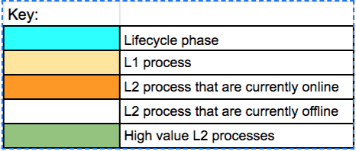
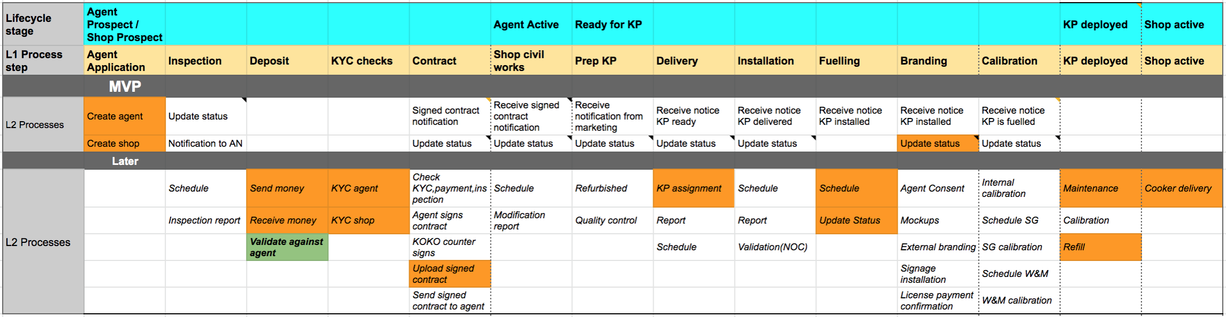
Onboarding MVP
Onboarding (L0) is a complex process made up of many L1 and L2 sub processes. Everything between ‘MVP’ and ‘Later’ lines is what needs to move on system. See here for zoomed in view.
The primary work to be done is to create status for each step that can be set by the user. A status change should update the team who picks up the next step [TBD; Is this a dashboard / Tableau report to view certain pipeline or user has to click to check...]

Slide 8
Onboarding
Offline process for MVP
Online process for MVP
Identify new
location
Agent Application
While this is not part of the MVP (due to complexity) moving this on system is high value and ‘next’ in terms of priority.
While this is not part of the MVP the KYC fields already exist in UVA so it would be easy to move this on system.
Inspection
Deposit
KYC
Contract
Pass?
Paid?
Pass?
Archive agent & shop
Signed?
N.B. Parallel processes
Civil works
Calibration
Fuelling
Sealed?
Complete?
Installation
Delivery
Branding
Complete?
Complete?
Complete?
Shop & KP active
Notes:
Can we only fuel a KP that is active? How do the first ones get filled? If they are not linked on system?
Is cooker delivery a mandatory step? Only really happens once shop is active?
Need a requirement for arhiving a shop from propspect status.

Slide 9
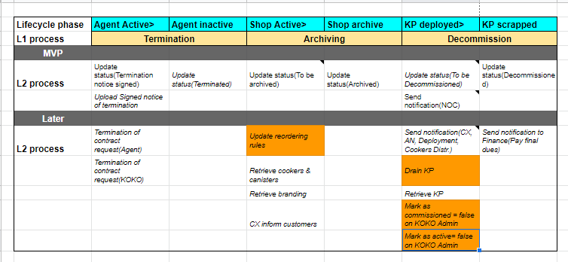
Offboarding MVP
Offline process for MVP
Online process for MVP
At the moment the entire decommissioning process is offline and requires a set of emails between teams, usually coordinated by Jecinta. The opportunity is for Legal to upload a termination on system which triggers a notification to other teams. Once a KP has been retrieved, Deployment should be able to update the KP status to decommissioned.
For discussion:
When does a shop count as decommissioned? Once notice has been issued or once KP has been removed?
Legal question on waiting for a countersigned contract before removing KP?
Proposed new process
Agent Network announces intention to terminate
Legal issue formal notice
Teams are informed
Finance processes payments
Retrieve KP and cookers
Update KP status

Slide 10
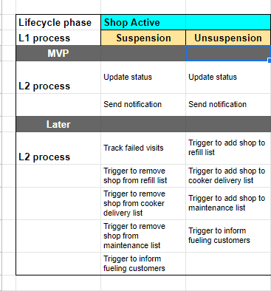
Suspension
Offline process for MVP
Online process for MVP
The suspension process is currently running off the AN problem tracker spreadsheet. Each operational team is to update the failed visits.
After a number of failed visits, the AN team have to contact the agent to come to a decision of the next steps to take e.g.
Suspend Service,
Provide Service (Resolved),
Planned for Decommissioning,
Provide Service (Under review),
Unsuspend Service.
We can aim to implement actions 1,3,5 with the MVP
Notification sent
Capture failed shop visits
Agent network intervention
Agent network update status
Triggers related to suspend service
Agent network update status
Triggers related to unsuspend service
Decommission

Slide 11
Next Steps
Align around MVP with Ari and Matt
Refine detailed requirements for onboarding, offboarding and suspension [example on next slide]
Validate current fields in Create Agent and Create Shop with Ari - is it fit for purpose?
Impact on longer term roadmap

Slide 12
Refinement for MVP processes
Agree approach

Slide 13
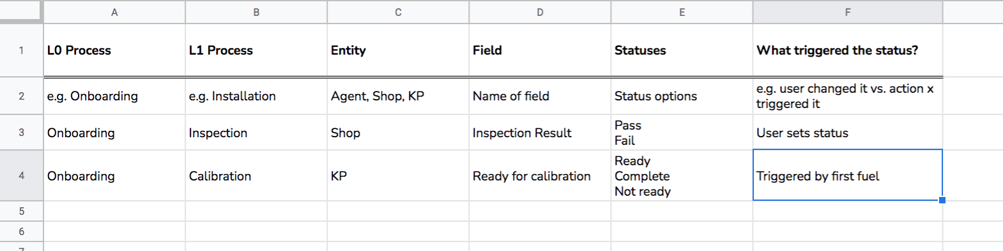
Next stage of detail
Once we agree the MVP we will look to build out the detailed requirements including:
Design / agree process flow (started on earlier slides)
Defining each status (see below)
Updated UI (E.g. new fields)

Slide 14
Validate requirements for create agent and create shop
With Agent Network team (Ari and co)

Slide 15
Validate create agent and shop
We completed an initial build for creating a shop and agent within UVA which is live and can be used once we complete the MVP.
We need to validate this with the Agent Network team and incorporate any new requirements for these processes.
Initial scope can be viewed here.
See next slides (or KOKO Core) for the feature.

Slide 16
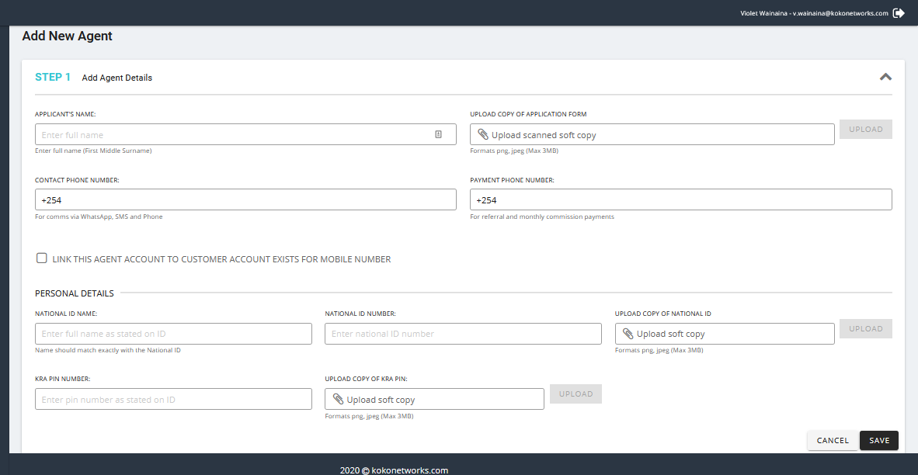
Create Agent
The functionality allows us to capture the following agent details:
Applicant’s name
Contact phone number
Payment phone number
Copy of Application form
Name on the national ID
Copy of National ID
National ID number
KRA PIN number
Copy of KRA PIN
Users who can create agents:
ARM’s
Commercial team admin
Questions:
Has this form captured the onboarding of agents fully or are there any new requirements?
Are there any users who need to be allowed to create agents?
Which teams can be notified after the creation of agents?

Slide 17
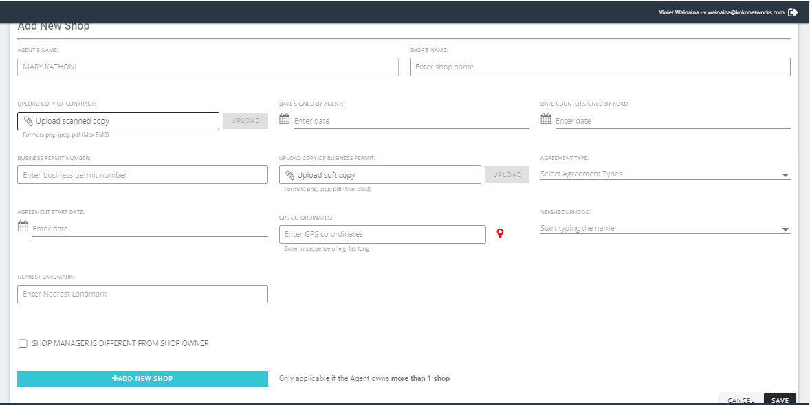
Create shop
The functionality allows us to capture the following shop details:
Agent
Shop Name
Copy of Contract
Date signed by agent
Date countersigned by agent
Business Permit number
Copy of business permit
Neighborhood
Nearest landmark
GPS coordinates
Shop Manager’s name
Shop Manager’s phone number
Agreement type
Users who can create shops:
ARM’s
Commercial team admin
Questions:
Has this form captured the onboarding of shops fully or are there any new requirements?
Are there any users who need to be allowed to create shops?
Which teams can be notified after the creation of shops?

Slide 18
Roadmap implications

Slide 19
Future requirements
The MVP is the beginning of the journey not the end of development. Most off the offline processes will need to come on system at some point during 2021 to allow us to expand the network.
In particular, there is further work to be done around:
Improving agent payments (deposits and commissions)
Schedule and run deployment activities (inspection to calibration)
Visibility of shop visits and deliveries (for us and agents)
Improving agent network management (e.g. ARM assignment)
Incorporate agent issue management (ticketing)
The MVP approach does not block the above from coming in later. Taking the example of deposits, bringing in a settlement process for the agent’s payment and then a check can be easily added to the flow of the existing platform.

Slide 20
Agent Roadmap 2021
Main objectives of Unified View of Agent Project
> Ease of access to agent related data
> Stop the reliance of spreadsheets to capture agent related data
> Reduce Odoo license cost
Suspension
ARR assignment
Improve agent payments
Offboarding
Relocation
Shop visits
Agent Issue Visibility
Custom Fields
Onboarding
Deposits
Agent Sales
Deployment Field App
Tags
Now
Next
Later

